Slide 1

CAPSTONE PROJECT
Hotel bookings data analysis
Presented By:
Student Name: VIKRAM K
College Name: University College of Engineering Ariyalur
Department: Electrical and Electronics Engineering

Slide 2
OUTLINE
Problem Statement
Proposed System/Solution
System Development Approach
Algorithm & Deployment
Result
Conclusion
Future Scope
References

Slide 3
Problem Statement
Have you ever wondered when the best time of year to book a hotel room is?
the optimal length of stay in order to get the best daily rate?
What if you wanted to predict whether or not a hotel was likely to receive a disproportionately high number of special requests?
This hotel booking dataset can help you explore those questions! This data set contains booking information for a city hotel and a resort hotel, and includes information such as when the booking was made, length of stay, the number of adults, children, and/or babies, and the number of available parking spaces, among other things.
All personally identifying information has been removed from the data.
Explore and analyse the data to discover important factors that govern the bookings.

Slide 4
Proposed Solution
From which countries do most guests come?
What is the average cost that guests pay per night for a hotel room?
Can you provide the breakdown of hotel nights spent by market segment and hotel type?
What are the primary meal preferences of guests when analyzing their preferences?
Can you provide an analysis of special requests made by customers?
What is the average duration of guests’ stays at the hotels?
Can you provide information on bookings categorized by market segment?

Slide 5
System Approach
Anaconda navigator software
JupyterLab (version: 4.0.11)
Python (version: 3.11.5)
jupterNote (version: 7.0.8)

Slide 6
Algorithm & Deployment
Dataset Introduction: We start by understanding the dataset. It contains information about two types of hotels (City and Resort) and whether bookings were canceled.
Features: Each observation represents a hotel booking and includes details like arrival date, length of stay, number of adults/children, etc.
Objective: Our goal is to analyze patterns, predict cancellations, and uncover factors governing bookings.
Understanding these patterns helps us tailor strategies to reduce cancellations and secure revenue.
The app provides visualizations, trends, and actionable insights.

Slide 7
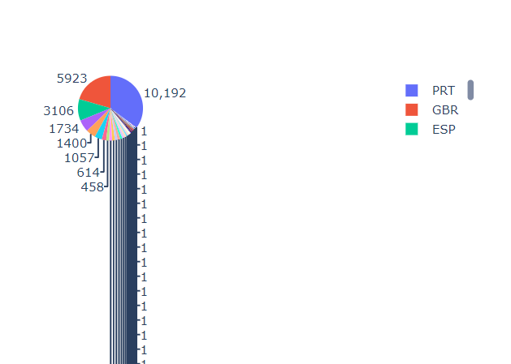
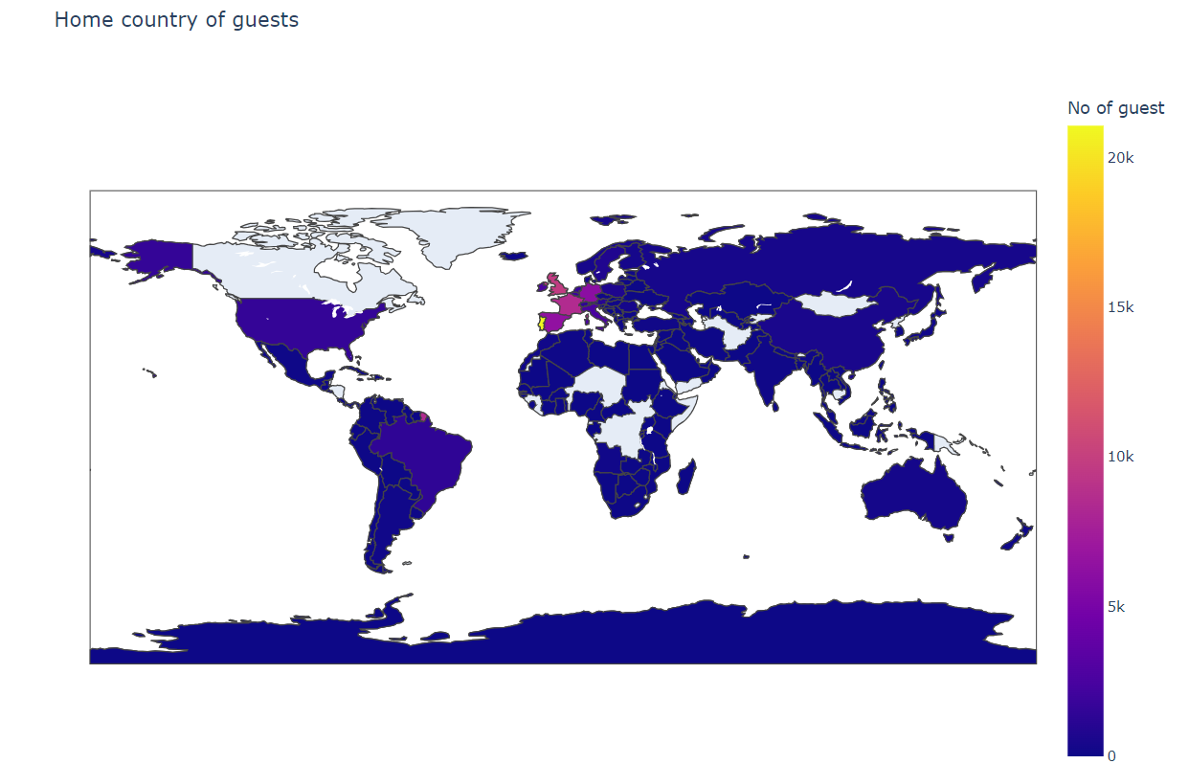
Result

Slide 8
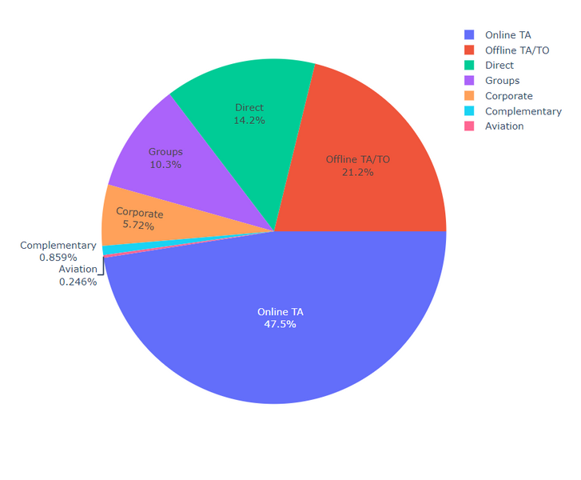
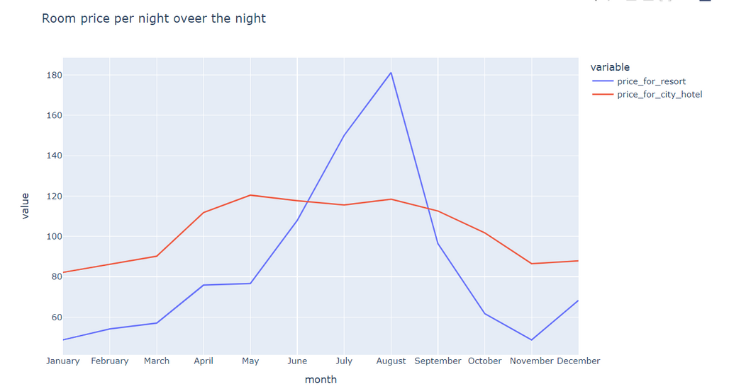
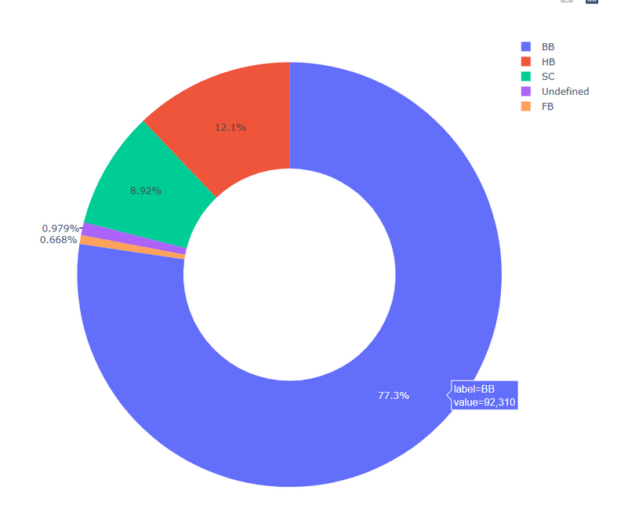
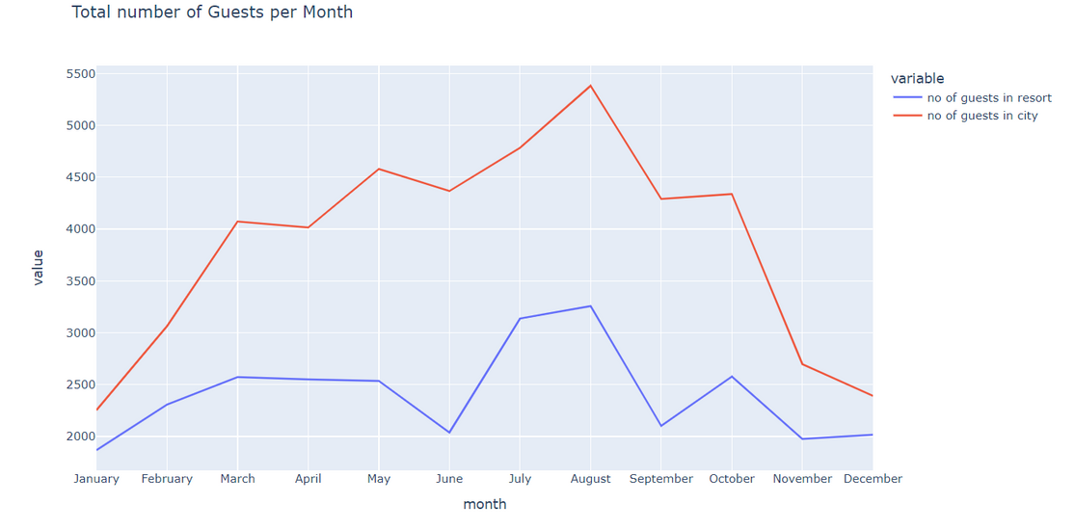
Result

Slide 9
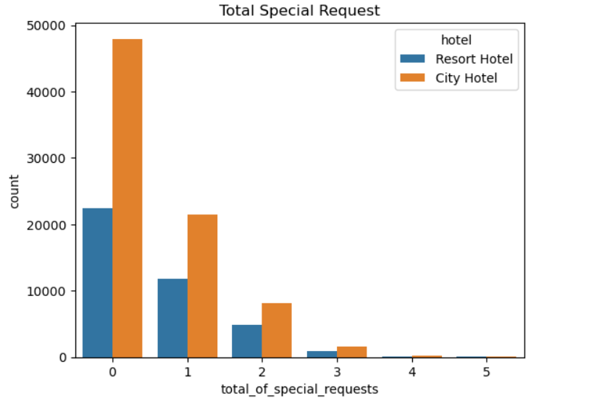
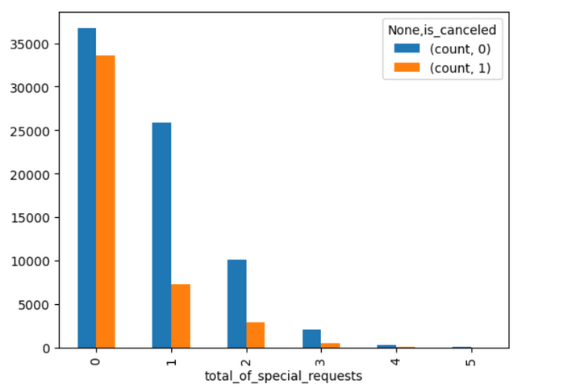
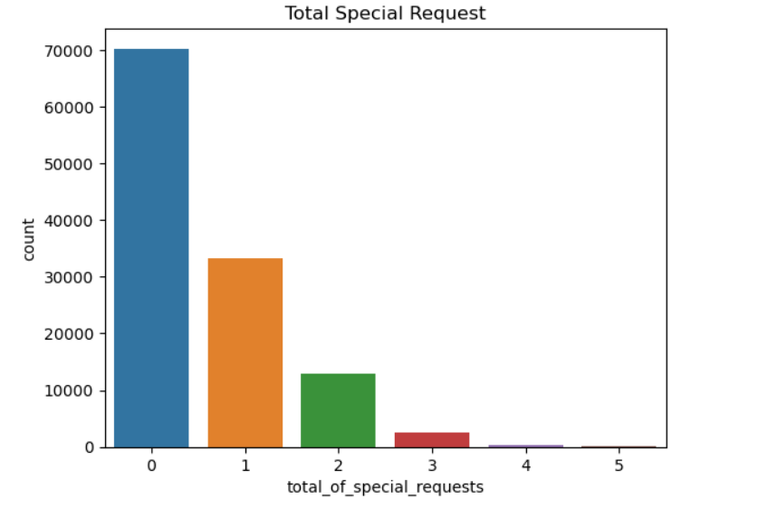
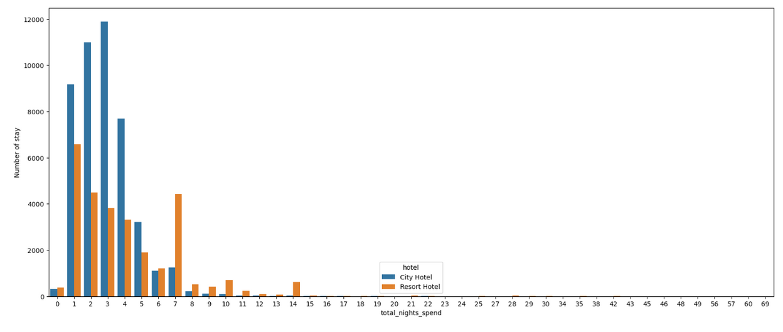
Result

Slide 10
Conclusion
The hotel booking dataset offers valuable insights into guest behavior and preferences.
By analyzing factors such as booking timing, length of stay, and special requests, we can optimize hotel operations and enhance guest experiences.
Key takeaways include identifying peak booking seasons, understanding guest preferences, and predicting demand for specific services.
Leveraging this data can lead to better decision-making and improved customer satisfaction.

Slide 11
Future scope
Develop predictive models to forecast booking patterns, cancellations, and special requests.
Analyze special requests made by guests and identify common themes.
Investigate dynamic pricing models based on booking timing, seasonal demand, and length of stay.
Implement personalized pricing recommendations for guests to optimize revenue.
Create personalized experiences by fulfilling unique guest preferences.
Compare booking trends with industry benchmarks.
Incorporate guest feedback data to enhance service quality.
Identify areas for improvement and prioritize enhancements.
Optimize parking space allocation based on historical utilization patterns.
Efficiently allocate staff and resources during peak seasons.

Slide 12
References
Matplotlib https://www.w3schools.com/python/matplotlib_intro.asp
Pandas https://www.w3schools.com/python/pandas/pandas_csv.asp
Dataframe https://pypi.org/project/sort-dataframeby-monthorweek/

Slide 13
THANK YOU

